Slide 1
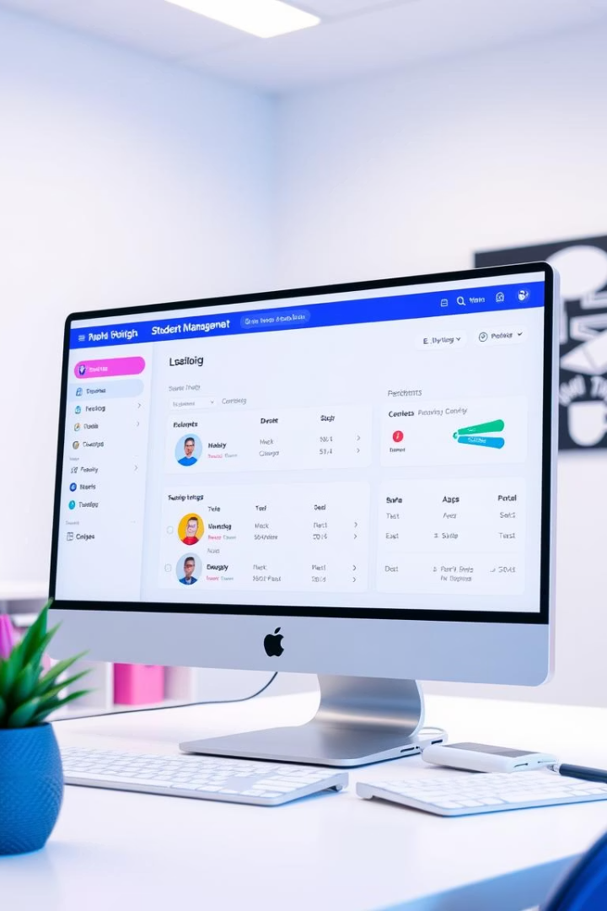
Student Management System
NAME : S.MONISHA
ORGANIZATION : MICRO IT
TOPIC : STUDENT MANAGEMENT SYSTEM

Slide 2
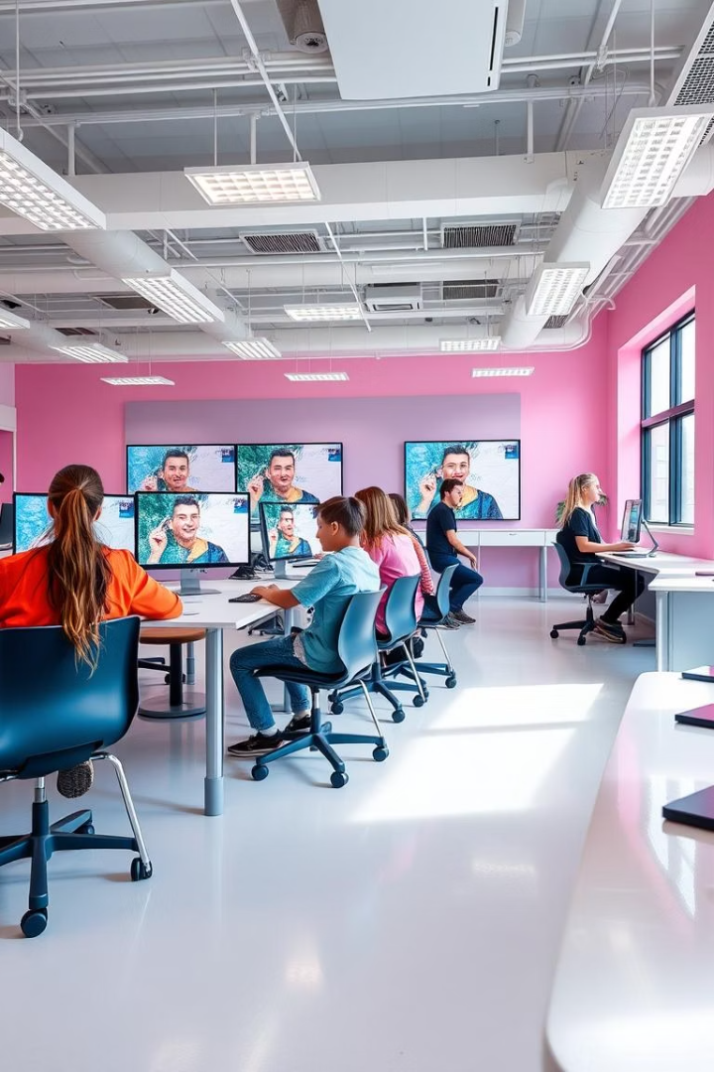
Student Management System with Python
Streamline student data, attendance, and grades efficiently. This open-source Python solution automates tasks, improves communication, and enhances administrative workflows in educational settings.

Slide 3
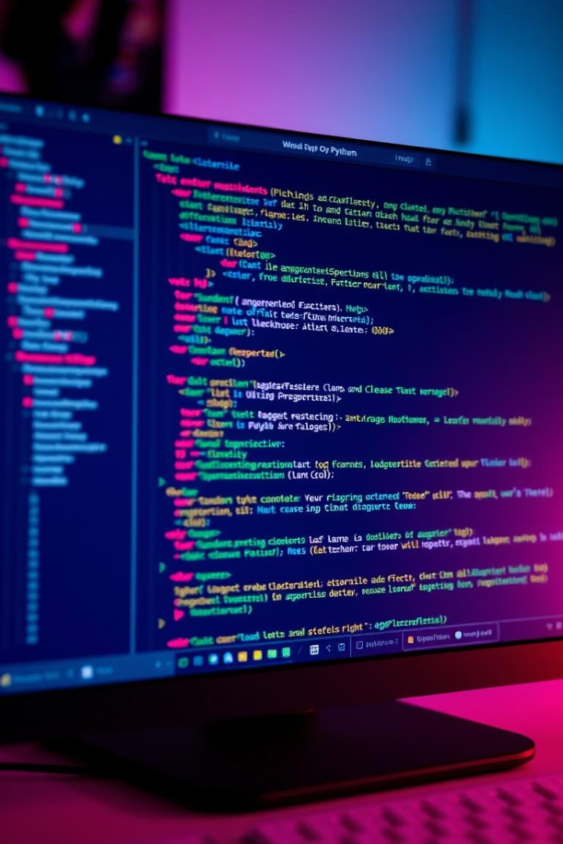
Core Functionality: Adding Students
Input Student Details
Database Integration
Collect name, ID, and contact information through Python scripts.
Connect with SQLite or MySQL to store student data securely.
Sample Function
Example: def add_student(name, id, contact): captures and stores records.

Slide 4
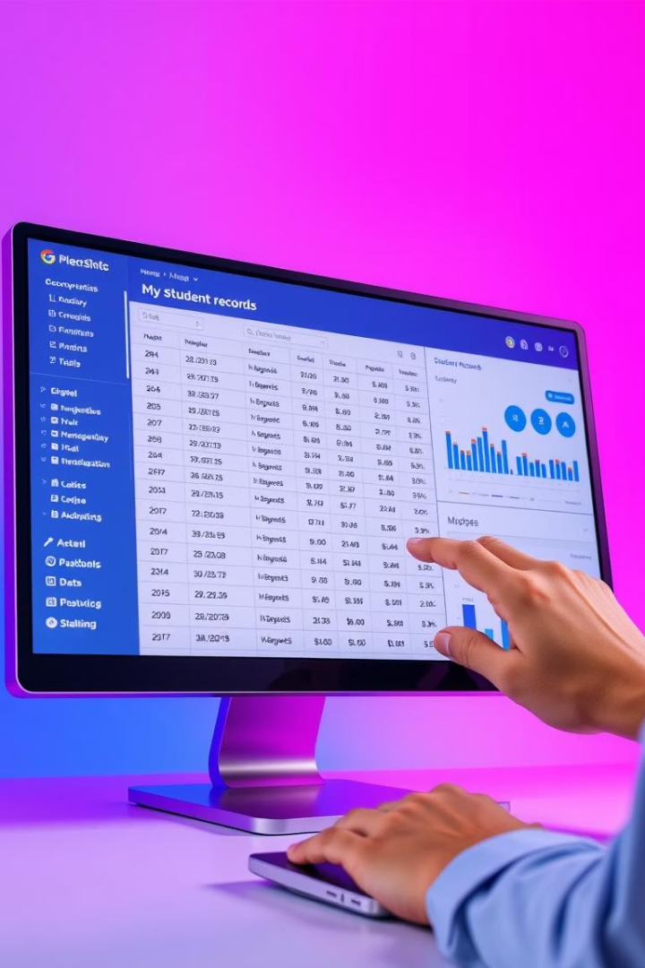
Core Functionality: Viewing and Searching
Tabular Display
Powerful Searching
Neatly present student records with tables for easy reading.
Search by name, ID, or criteria to quickly find students.
Python Libraries
Use tabulate and prettytable for polished data views.

Slide 5
Core Functionality: Updating and Deleting
Update Records
Delete with Care
Error Handling
Modify student info safely with validation checks.
Confirm deletions to prevent accidental data loss.
Implement robust validation and manage exceptions.

Slide 6
Tools and Technologies Used
Python programming language
SQLite and MySQL for database management
OpenCV library for facial recognition
Tabulate and PrettyTable for data presentation
Matplotlib or similar libraries for data visualization

Slide 7
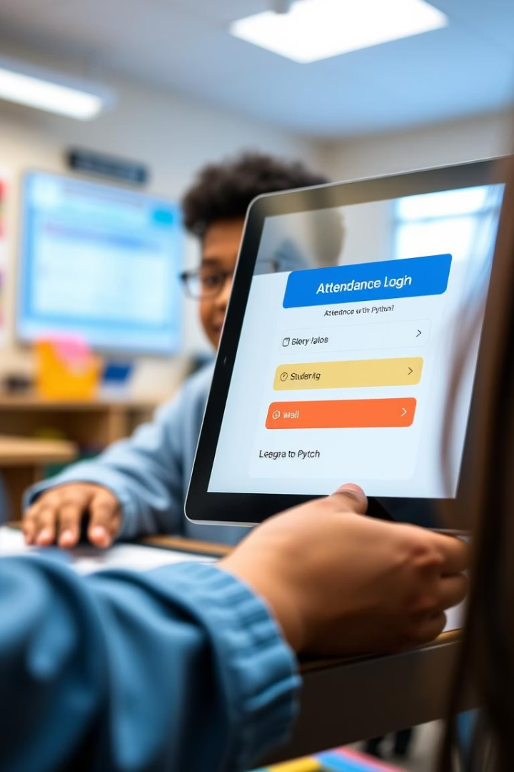



Advanced Feature: Attendance Tracking
Log Attendance
Use Python scripts to record daily student presence.
Generate Reports
Produce detailed attendance summaries for analysis.
Facial Recognition
Integrate OpenCV for automated attendance marking.

Slide 8



Advanced Feature: Grade Management
Calculate GPA
2
Automate GPA computation and transcript generation.
Store Grades
1
Keep academic scores organized in the database.
Visualize Performance
Create charts to illustrate student progress effectively.
3

Slide 9

Next Steps and Implementation
Setup Environment
Install Python and required libraries for development.
Develop Modules
Build and test core functionalities step-by-step.
Deploy & Train
Implement system and train staff for smooth adoption.

Slide 10

Challenges Faced
Ensuring data accuracy and consistency across modules
Handling user input validation and preventing errors
Integrating advanced features like facial recognition smoothly
Maintaining system performance with growing data size
Providing an intuitive interface for non-technical users

Slide 11

Learning Outcomes
Understand core Python programming concepts
Be able to manage student records efficiently
Implement attendance tracking and grade management
Develop skills in data visualization and reporting

Slide 12

Benefits and Conclusion
Boost Efficiency
Reduce administrative burdens with automation.
Enhance Data Accuracy
Access reliable student information anytime.
Improve Communication
Facilitate better reporting and interaction.
Customizable & Open-Source
Adapt the system to unique institutional needs.

Slide 13

Future Scope
Explore potential advancements such as integrating AI-driven analytics for personalized learning, expanding mobile accessibility, and incorporating advanced security features to protect student data.
Future enhancements may also include real-time notifications for parents and teachers, comprehensive integration with other educational platforms, and multilingual support for broader usability.

